Slide 1
Exploratory Data Analysis (EDA) on Bank Telemarketing Campaign
Report by : Kavita Kumari

Slide 2
Objective of EDA
Identifying patterns and providing insights to improve the positive response rate.
Analyze the campaign dataset, identify patterns, and provide data-driven recommendations to enhance the telemarketing campaign's success.

Slide 3
Understanding the Dataset
The dataset includes information about the customers and their responses to the campaign. Typical features might include:
Customer Demographics : Age, job, marital status, education, salary, balance.
Campaign Information : Contact details, loan, housing loan.
Temporal Data : Dates and times of contact, response times.
Previous Campaigns : Information about previous campaigns and their outcomes.

Slide 4
Handling of Missing Values & Data Inconsistencies
Scrutinize the dataset to comprehend its structure, encompassing columns and data types
Identified the missing values in the given dataset.
Replaced the missing values of age column with the median and response and month with the mode.
Addressed the data inconsistencies i.e. format and outliers in the given dataset.

Slide 5
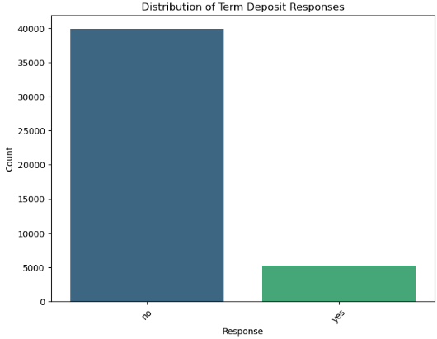
Distribution of Target Variables

Slide 6
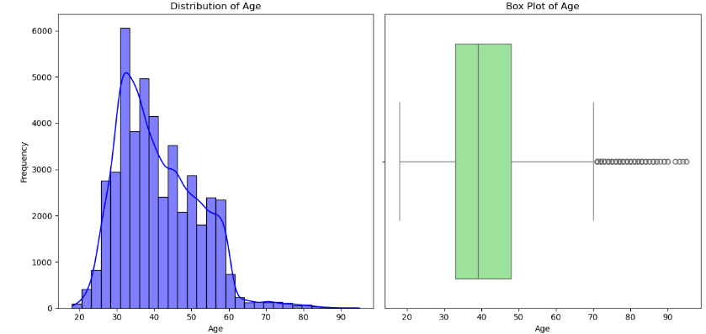
Univariate Analysis of Age

Slide 7
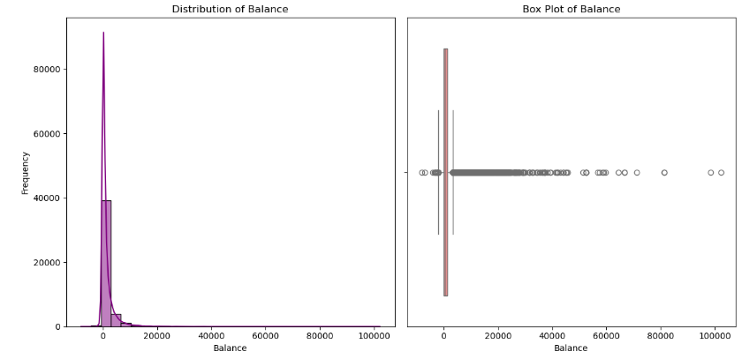
Univariate Analysis of Balance

Slide 8
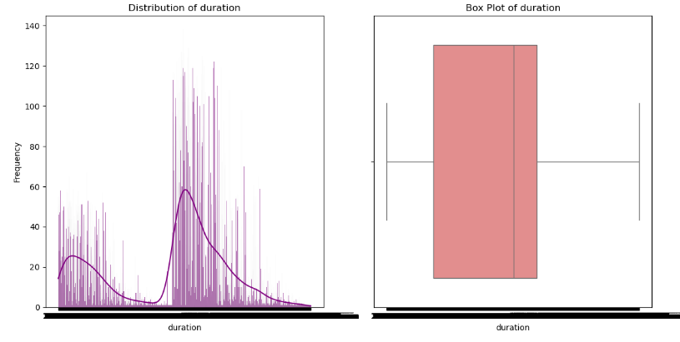
Univariate Analysis of Call Duration

Slide 9
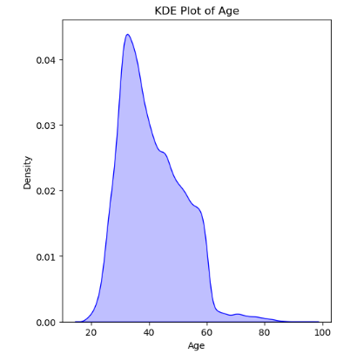
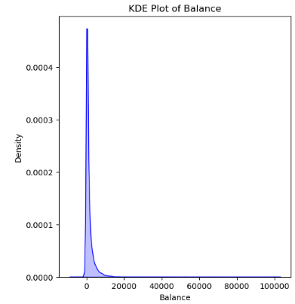
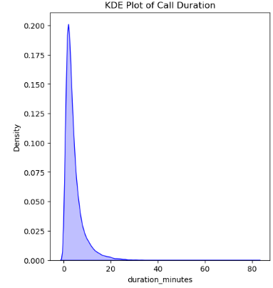
Univariate Analysis done using KDE plot

Slide 10
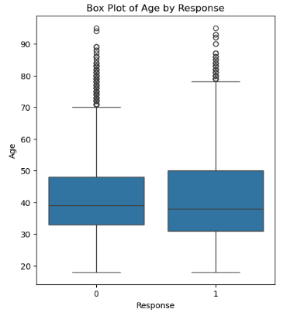
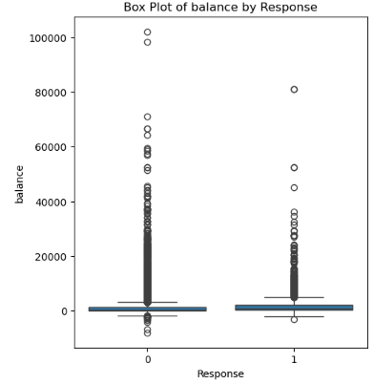
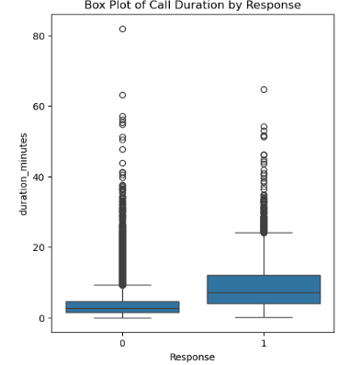
Bivariate Analysis

Slide 11
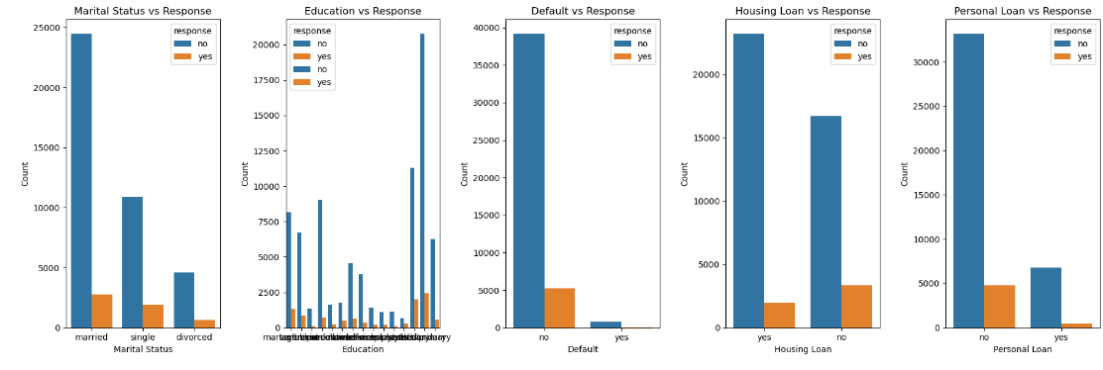
Bivariate Analysis Using Bar Charts

Slide 12
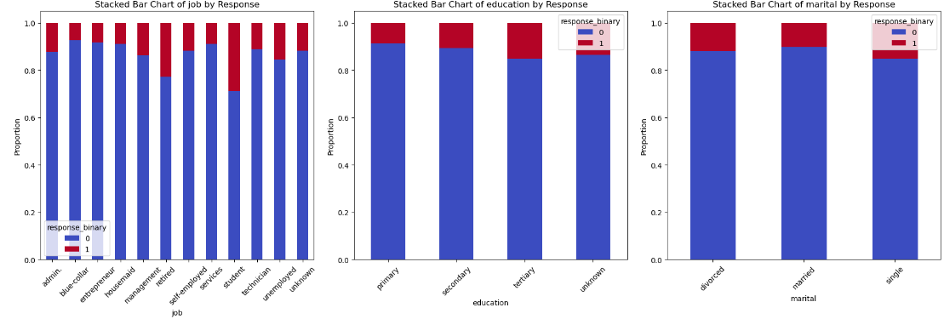
Bivariate Analysis Using Stacked Bar Charts

Slide 13
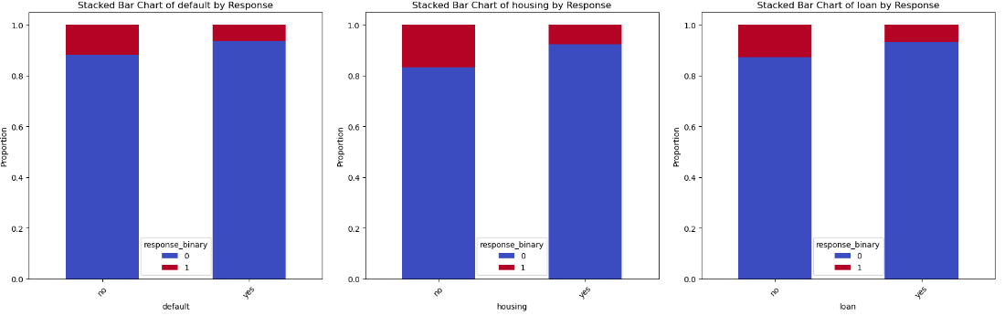
Bivariate Analysis Using Stacked Bar Charts

Slide 14
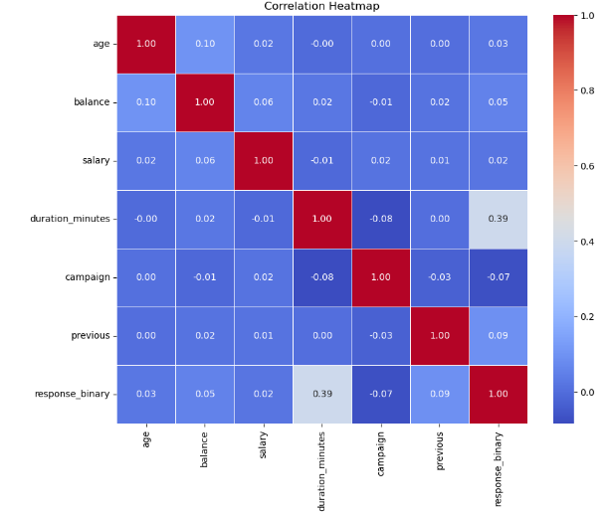
Correlation Heatmap

Slide 15
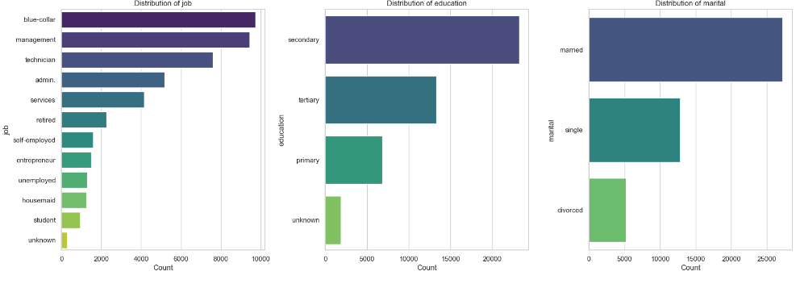
Distribution of Categorical Variables

Slide 16
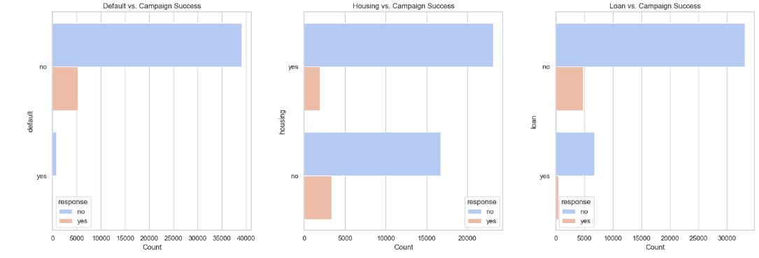
Impact of categorical variables on campaign's success

Slide 17
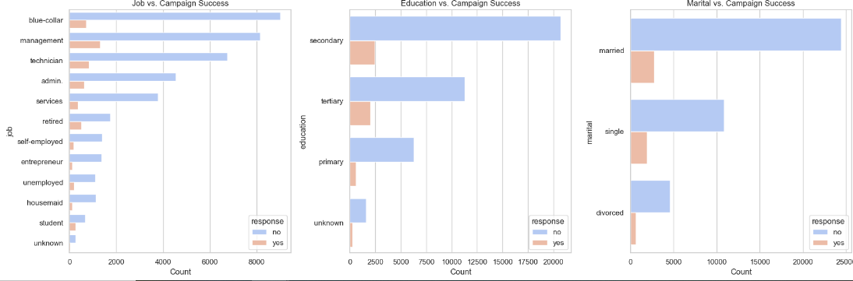
Impact of categorical variables on campaign's success

Slide 18
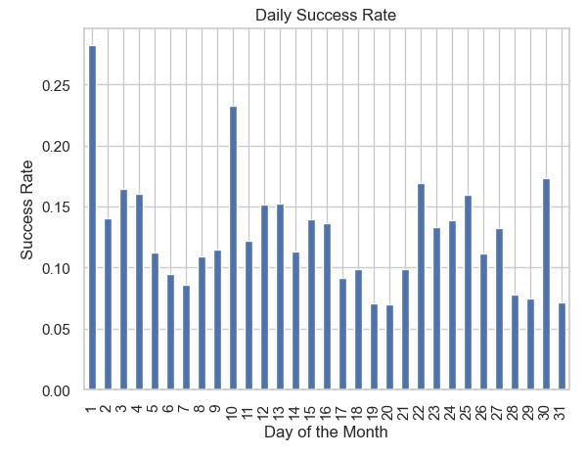
Temporal Analysis of the campaign over time

Slide 19
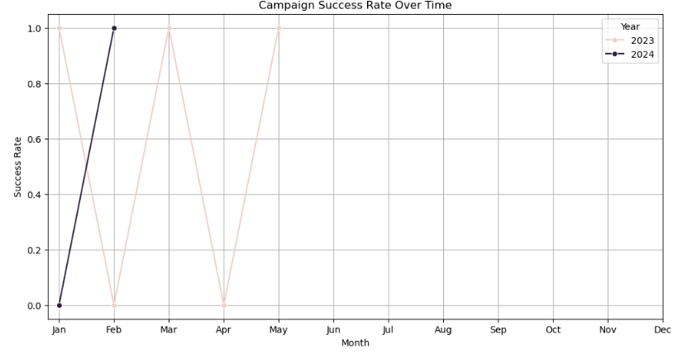
Temporal Analysis of the campaign over time

Slide 20
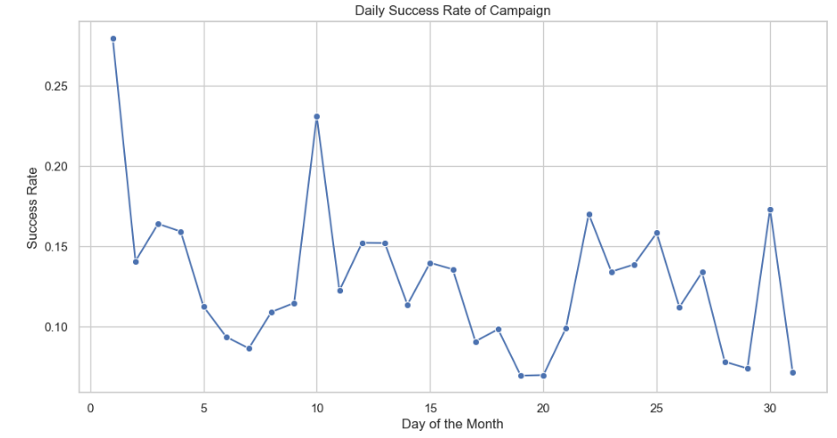
Superior Campaign Performance

Slide 21
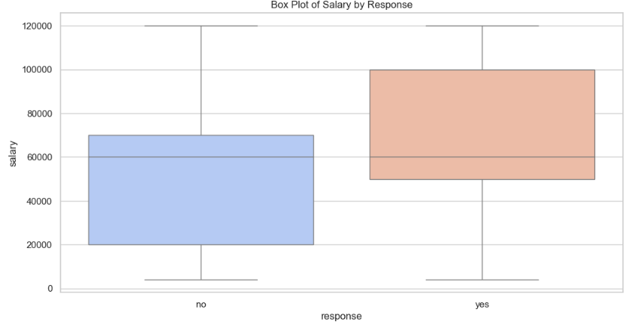
Correlated Feature Influence the Target Variable

Slide 22
Conclusion
Insights derived from our comprehensive data analysis provide a robust foundation for enhancing the bank's positive response rates.
By leveraging detailed customer demographics, optimizing campaign timing, refining communication strategies, and addressing data inconsistencies, the bank can significantly improve its engagement with customers.

Slide 23
Recommendations
Design personalized marketing campaigns that resonate with specific demographic segments.
Develop offers and incentives that appeal to the unique preferences and needs of different customer groups.
Adjust campaign timings based on seasonal trends, holidays, and significant events that impact customer behavior.
Conduct periodic reviews and audits to assess the effectiveness of strategies and make necessary adjustments.

Slide 24
THANK YOU

